Slide 1
Unit 2. Structure and function of the nervous system: Molecular, cellullar, synaptic, and circuit levels.
2.1. The cells of the nervous system
2.2. Resting and action potential
Resting potential
Changes in resting potential:
Local Potentials
Action potential
Electrophysiology (phases of the action potential)
Stimulus codification
Ionic foundations
Refractory periods
Conduction of the action potential
2.3. Synaptic transmission
2.4. Synaptic plasticity

Slide 2
CHANGES IN MEMBRANE POTENTIAL
Recommended reading
http://www.mc3cb.com/pdf_ap_lectures/C12_2_electrical_potentials.pdf
Two different changes in membrane potential
Local potentials
Action potential

Slide 3
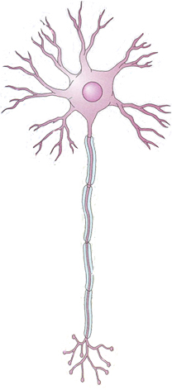
CHANGES IN MEMBRANE POTENTIAL: Local potentials
mV
+ 40
0
-70
t
-90
Depolarization(loss of inner negativity)

Slide 4
CHANGES IN MEMBRANE POTENTIAL: Local potentials
Vm
+ 40
0
-70
t
-90
Hyperpolarization (increased inner negativity)

Slide 5
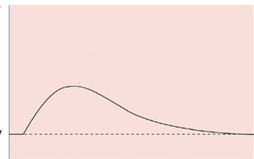
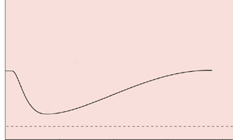
CHANGES IN MEMBRANE POTENTIAL: Local potentials
LOCAL POTENTIAL
Small change in membrane potential
DEPOLARIZATION
Negativity of the membrane potential is LOWER compared to resting potential.
HYPERPOLARIZATION:
Negativity of the membrane potential is HIGHER compared to resting potential.

Slide 6
CHANGES IN MEMBRANE POTENTIAL: Local potentials
and
Local potentials
Present in all cells
Their amplitude is proportional to stimulus intensity
Can be generated in any part of the neuron membrane
(soma, dendrites, axon)
Electrotonic or passive conduction (spread)
The amplitude of the potential is reduced when being propagated

Slide 7
CHANGES IN MEMBRANE POTENTIAL: Action potential
mV
+ 40
0
-60
t
-90
Action potential

Slide 8
CHANGES IN MEMBRANE POTENTIAL: Action potential
Can be generated by neurons, muscle cells and glandular cells
In neurons, they are only generated in axon membrane
Amplitude NOT proportional to stimulus intensity
They are propagated without any amplitude loss
All or none law
Active conduction

Slide 9
Minimum stimulus intensity required to generate an action potential.
THRESHOLD STIMULUS AND SPIKING THRESHOLD
THRESHOLD STIMULUS
SPIKE THRESHOLD (THRESHOLD POTENTIAL):
Specific membrane potential that must be reached in order for an action potential (spike) to be triggered. It is always a value less negative than the resting potential (DEPOLARITATION)
It may be different in different neurons, and may also vary in a given neuron under certain circumstances

Slide 10
Electrophysiology (Phases)
Positive values are always reached (+40/+50mV)
Membrane potential (mV)
All-or-none law
+40
How is stimulus intensity coded?
DEPOLARIZATION
REPOLARIZATION
Time (msec)
0
PR
-70
-80
HYPERPOLARIZATION

Slide 11
ACTION POTENTIAL: STIMULUS CODING
Stimulus intensity
A B
1
Spiking threshold
2
A
B
3
Threshold stimulus
4
5
Intensity → Spike frequency

Slide 12
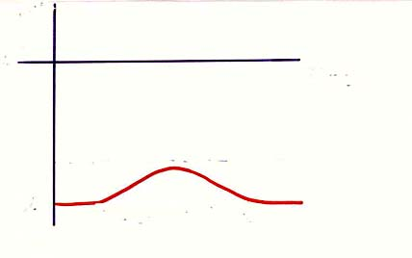
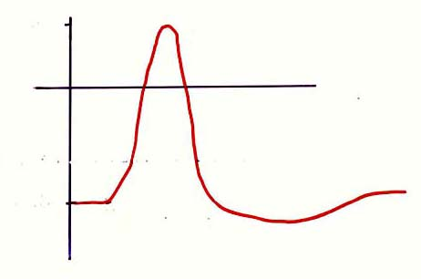
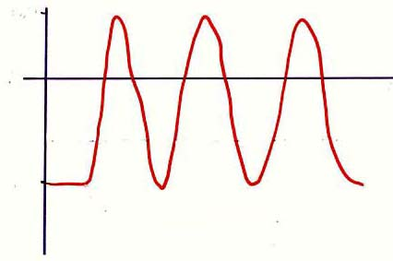
ACTION POTENTIAL: STIMULUS CODING
SUBTHRESHOLD STIMULUS
THRESHOLD STIMULUS
LOCAL POTENTIAL
ACTION POTENTIAL
mV
0
msec
AMPLITUDE
Threshold
Threshold
-70
SUPRATHRESHOLD STIMULUS
TRAINS OF ACTION POTENTIALS
Threshold

Slide 13

ACTION POTENTIAL: IONIC FOUNDATIONS
K⁺
Na⁺
Membrane potential
(mV)
+40
Time
(msec)
0
VOLTAGE-GATED CHANNELS
LEAKAGE CHANNELS
RP
-70
Usually closed
They open when certain depolarization value is achieved

Slide 14
ACTION POTENTIAL: IONIC FOUNDATIONS
K⁺
Na⁺
Membrane potential (mV)
E
Na⁺
+55
+40
Temps (mseg)
0
Ion movement throughout the neuron membrane?
Is the membrane permeable to that ion?
NO
No movement
RP
-70
-75
YES
E
K⁺
The ion will cross the membrane trying to get its equilibrium potential

Slide 15
ACTION POTENTIAL: IONIC FOUNDATIONS
K⁺
Na⁺
Membrane potential (mV)
E
Na⁺
+55
+40
Time (msec)
0
RP
-70
-75
E
K⁺

Slide 16
ACTION POTENTIAL: IONIC FOUNDATIONS
K⁺
Na⁺
Membrane potential (mV)
E
Na⁺
+55
+40
Time
(msec)
0
RP
-70
-75
E
K⁺

Slide 17
ACTION POTENTIAL: IONIC FOUNDATIONS
K⁺
Na⁺
Membrane potential
(mV)
E
Na⁺
+55
+40
Time
(msec)
0
Spiking threshold
RP
-70
Minimun value of depolarization of membrane potential needed to induce an action potential
-75
E
K⁺

Slide 18
ACTION POTENTIAL: IONIC FOUNDATIONS
K⁺
Na⁺
Membrane potential
(mV)
E
Na⁺
+55
+40
Time
(msec)
0
Is the membrane permeable to that ion?
NO
No movement
RP
-70
-75
YES
Na+
E
K⁺
Sodium Will cross the membrane (inside) trying to get its equilibrium potential

Slide 19
ACTION POTENTIAL: IONIC FOUNDATIONS
K⁺
Na⁺
Membrane potential
(mV)
E
Na⁺
+55
+40
Time
(msec)
0
Is the membrane permeable to that ion?
Na+
NO
No movement
RP
-70
-75
YES
K+
E
K⁺
More than during resting potential

Slide 20
ACTION POTENTIAL: IONIC FOUNDATIONS
K⁺
Na⁺
E
Na⁺
+55
+40
0
Is the membrane permeable to that ion?
Na+
NO
No movement
RP
-70
-75
YES
K+
E
K⁺
K+ Will cross the membrane (to the outside) trying to reach its equilibrium potential
More than during resting potential

Slide 21
ACTION POTENTIAL: IONIC FOUNDATIONS
K⁺
Na⁺
E
Na⁺
+55
+40
0
Is the membrane permeable to that ion?
Na+
NO
No movement
RP
-70
-75
YES
K+
E
K⁺
K+ Will cross the membrane (to the outside) trying to reach its equilibrium potential

Slide 22
ACTION POTENTIAL: IONIC FOUNDATIONS
K⁺
Na⁺
E
Na⁺
+55
Na⁺/K⁺
+40
0
All ion movements during an action potential are down their gradient
. Na⁺/K⁺ pump restores ion inner and outer concentrations AFTER each action potential, but it is not responsable of any of their phases
RP
-70
-75
E
K⁺

Slide 23
ACTION POTENTIAL: IONIC FOUNDATIONS
+55
+40
Membrane Potential
0
Na⁺
Out
Time
(msec)
RP
-70
-75
In
K⁺
Membrane conductance
Na⁺ K⁺
Time
(msec)

Slide 24
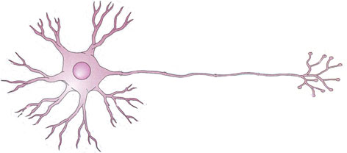
CONDUCTION OF ACTION POTENTIALS IN UNMYELINATED AXONS
While local currents are conducted both in orthodromic and antidromic directions, action potentials are usually only conducted in orthodromic sense. This is due to the existence of refractory periods
Axon hillock
https://www.youtube.com/watch?v=pbg5E9GCNVE

Slide 25
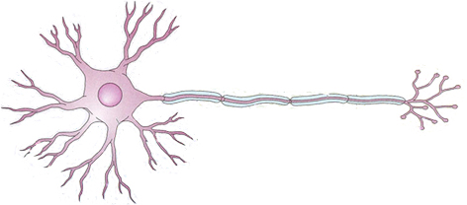
CONDUCTION OF ACTION POTENTIALS IN MYELINATED AXONS
SALTATORY CONDUCTION
Orthodromic or anterograde sense

Slide 26
CONDUCTION OF ACTION POTENTIALS IN MYELINATED AXONS
4. CONDUCCIÓ DE L’IMPULS NERVIÓS:
Local potentials generated by the local currents of Na+ ions that entered the neuron during the action potential
Action potential
Node of Ranvier
(Very rich in voltage-gated Na+ channels)
Internode
(Voltage-gated Na+ channels are virtually absent)
Myelin acts as an electrical isolator, limiting the loss of ions through the cell membrane, so that the loss of amplitude of local potentials is slower than without myelin
Therefore, the amplitude of the local potential is still big enough to reach the spiking threshold in the next node of ranvier

Slide 27
CONDUCTION OF ACTION POTENTIALS
Advantages of saltatory conduction
Higher conduction speed
Myelinated
Unmyelinated

Slide 28
CONDUCTION OF ACTION POTENTIALS
Advantages of saltatory conduction
Higher conduction speed
Lower energy expense (due to the fact that the Na+-K+ pump has to work very hard only in the nodes of ranvier after every action potential)
Myelinated
Unmyelinated
https://www.youtube.com/watch?v=ENE3z9lqQ-k

Slide 29
CONDUCTION OF ACTION POTENTIALS
Speed of conduction of action potentials
It depends mainly on:
1. Myelin: Speed is higher in myelinated axons
2. Axon diameter: Speed is higher in thicker axons
Some invertebrate animals (such as squids) have very thick axons to compesate for the lack of myelin

